Slide 1
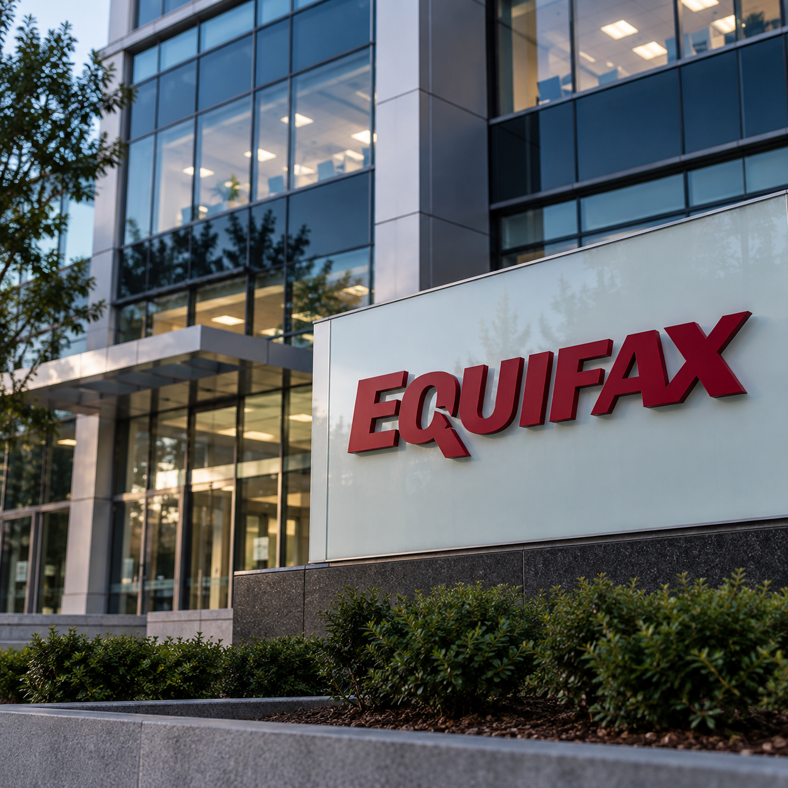
The Equifax Data Breach (2017)
What Happened?
In 2017, Equifax, a major credit reporting company experienced a significant data breach
Hackers exploited an unpatched vulnerability in Apache Struts (Java web application framework).
Breach occurred between May and July of 2017 (publicly disclosed in September 2017).
Although a security patch was available in March 2017, Equifax failed to apply it to the affected system.
Source: U.S. Government Accountability Office (2018)

Slide 2

Impact & Lessons Learned
Approximately 147 Million Individuals Affected
Financial Impact
- In 2019 Equifax agreed to a settlement of at least $575 million following the breach
Compromised Personal Information
The breach exposed sensitive consumer information, including names, date of birth, residential addresses, and Social Security numbers
Unauthorized disclosure of personal data increased the potential for identity theft and financial fraud
Implications for Software Development
Timely Security Updates: Ensure security patches are implemented promptly to mitigate known vulnerabilities
Vulnerability Management: Conduct routine security assessments to identify and remediate potential weaknesses
Data Protection: Establish comprehensive cybersecurity protocols to safeguard sensitive information and prevent unauthorized access.
Source: Federal Trade Commission (2019)

